Slide 1

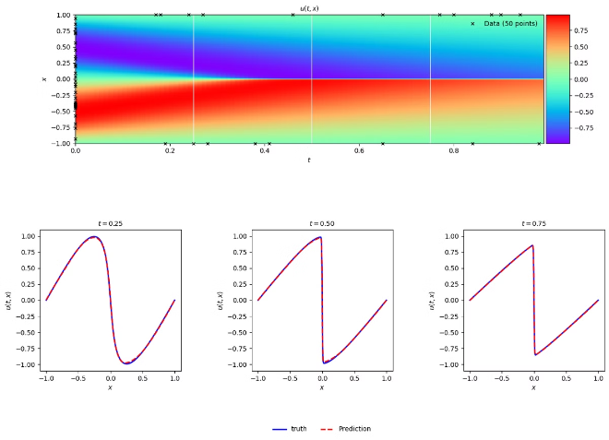
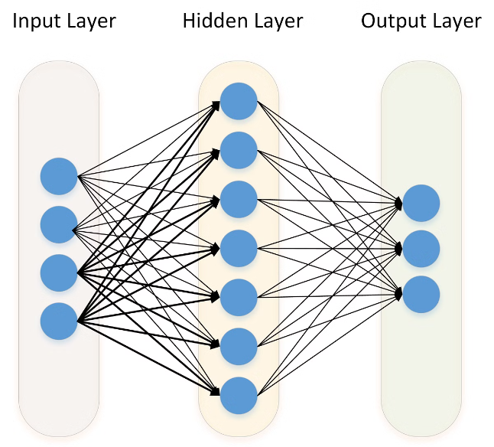
Introduction to Physics Informed Neural Networks (PINNs)
Physics Informed Neural Networks (PINNs) are a revolutionary approach in machine learning that seamlessly integrates physical laws and principles into the neural network architecture. By leveraging the power of deep learning and the fundamental understanding of physical phenomena, PINNs offer a unique way to solve complex problems that traditional numerical methods may struggle with. This presentation will provide a comprehensive overview of the key concepts, advantages, and applications of PINNs, equipping you with the knowledge to harness their potential in your own research and problem-solving endeavors.

Slide 2

Motivation and Advantages of PINNs
1
Improved Accuracy
2
Enhanced Interpretability
By incorporating physical constraints, PINNs can provide more accurate predictions compared to standard data-driven models, especially in scenarios with limited data or complex, noisy environments.
The explicit inclusion of physical laws in the neural network architecture allows for better interpretability of the model's behavior and decisions, providing valuable insights into the underlying physical processes.
3
Reduced Computational Cost
4
Generalization Capabilities
PINNs can significantly reduce the computational resources required for model training and inference, as they leverage the inherent structure of the physical system being studied.
PINNs are more adept at generalizing to new scenarios beyond the training data, as they can adapt to different physical conditions and parameters based on the embedded physical knowledge.
5
Overcoming Data Limitations
Traditional machine learning models often require large datasets to achieve accurate predictions. PINNs, on the other hand, can leverage the underlying physical laws to reduce the reliance on extensive training data, making them particularly useful in domains where data is scarce or expensive to obtain.

Slide 3

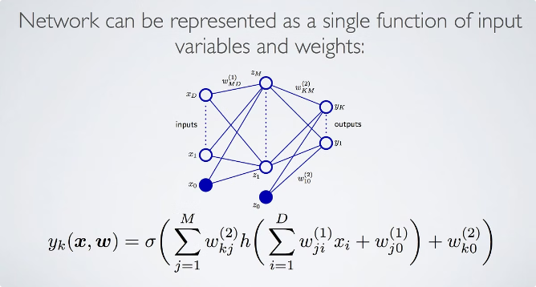
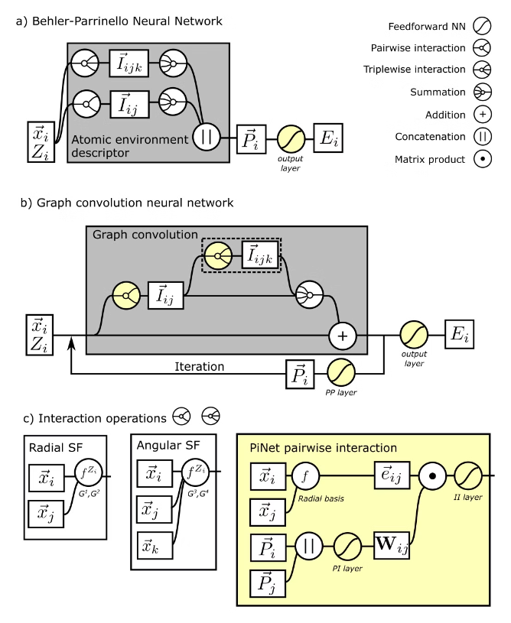
Fundamental Concepts of PINNs
1
Governing Equations
2
Boundary and Initial Conditions
PINNs incorporate the governing equations (PDEs or other types of differential equations) that describe the physical system, ensuring that the neural network's outputs satisfy the underlying physical laws and constraints.
PINNs incorporate the relevant boundary and initial conditions, which are crucial for accurately modelling the behavior of physical systems and ensuring the predicted solutions are physically consistent.
3
Automatic Differentiation
4
Physics-Informed Loss Function
PINNs leverage automatic differentiation techniques to efficiently compute the gradients of the neural network outputs with respect to the input variables, enabling the incorporation of physical constraints and the training of the model.
The loss function for training PINNs is designed to minimize the discrepancy between the neural network predictions and the underlying physical laws, ensuring that the model's outputs are consistent with the known physics.

Slide 4
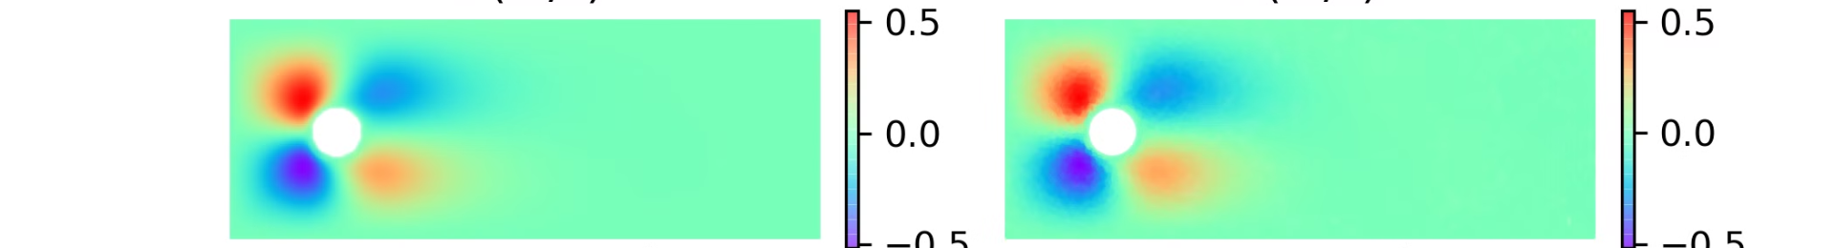
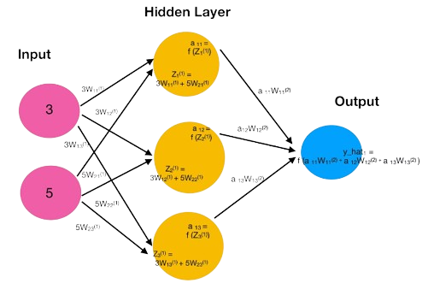
Incorporating Physical Laws into Neural Networks
Embedding Physical Constraints
Automatic Differentiation
PINNs embed the physical constraints, such as governing equations and boundary conditions, directly into the neural network architecture, ensuring that the model's outputs satisfy the underlying physical principles.
PINNs leverage automatic differentiation techniques to efficiently compute the gradients of the neural network outputs with respect to the input variables, enabling the incorporation of physical constraints during the training process.
1
2
3
Loss Function Design
The loss function of a PINN is designed to minimize the discrepancy between the predicted outputs and the physical constraints, incentivizing the neural network to learn solutions that adhere to the governing laws.

Slide 5

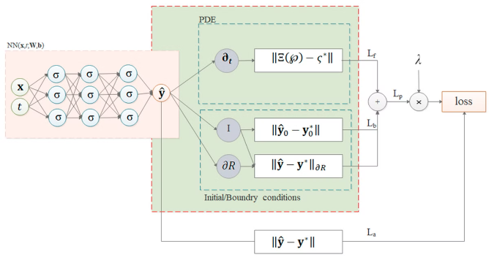
Incorporating Physical Laws into Neural Networks
1
Differential Equations
2
Boundary Conditions
PINNs can directly incorporate differential equations, such as Navier-Stokes equations or the heat equation, into the neural network architecture. This ensures that the model's predictions satisfy the underlying physical constraints.
PINNs can also incorporate boundary conditions, which define the behavior of the system at the boundaries of the problem domain. This helps the model respect the physical constraints at the boundaries, leading to more accurate and realistic predictions.
3
Conservation Laws
4
Constitutive Relations
PINNs can enforce conservation laws, such as mass, momentum, or energy conservation, by directly incorporating these principles into the neural network architecture. This ensures that the model's predictions are consistent with the fundamental physical laws governing the system.
PINNs can incorporate constitutive relations, which describe the relationship between different physical quantities, such as stress and strain in solid mechanics or viscosity and shear rate in fluid dynamics. This helps the model capture the underlying material behavior.

Slide 6
PINN Architecture and Training Process
PINN Architecture
Training Process
Regularization and Convergence
The PINN architecture typically consists of an input layer, multiple hidden layers, and an output layer. The hidden layers learn to capture the complex relationships between the input variables and the physical quantities of interest, while the output layer generates the final predictions that satisfy the physical constraints.
The training of a PINN involves minimizing a loss function that combines the discrepancy between the predicted outputs and the observed data, as well as the discrepancy between the predicted outputs and the physical constraints. This optimization process leverages gradient-based techniques, such as backpropagation, to update the neural network parameters.
Appropriate regularization techniques and optimization strategies are crucial for ensuring the convergence of the PINN training process and mitigating potential issues like overfitting or instability. Careful hyperparameter tuning is often required to achieve optimal performance.

Slide 7

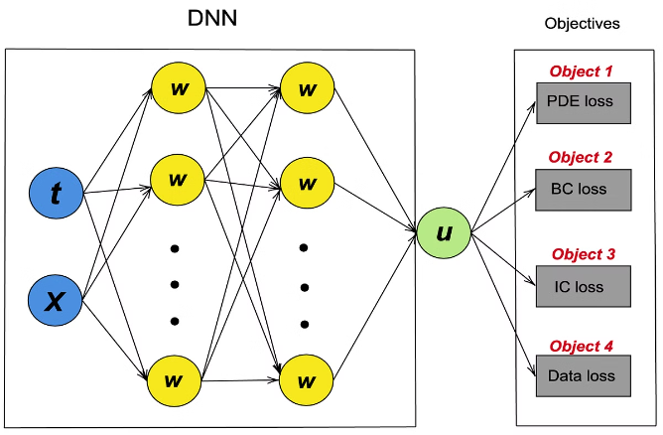
Governing Equations and Boundary Conditions
Governing Equations
Boundary Conditions
PINNs can handle a wide range of governing equations, including partial differential equations (PDEs), ordinary differential equations (ODEs), and integro-differential equations. The ability to incorporate these physical laws into the neural network architecture is a key strength of the PINN approach.
PINNs can incorporate various types of boundary conditions, such as Dirichlet, Neumann, and Robin conditions, to ensure that the predicted solutions satisfy the physical constraints at the boundaries of the domain. This is crucial for accurately modeling real-world physical systems.
Initial Conditions
Weak Form Formulation
In the case of time-dependent problems, PINNs can also incorporate initial conditions, which define the initial state of the system and guide the evolution of the solution over time. The inclusion of both boundary and initial conditions is a hallmark of the PINN approach.
PINNs often utilize a weak form formulation, which allows for the incorporation of physical constraints in a more flexible and robust manner, particularly for problems with complex geometries or boundary conditions.

Slide 8

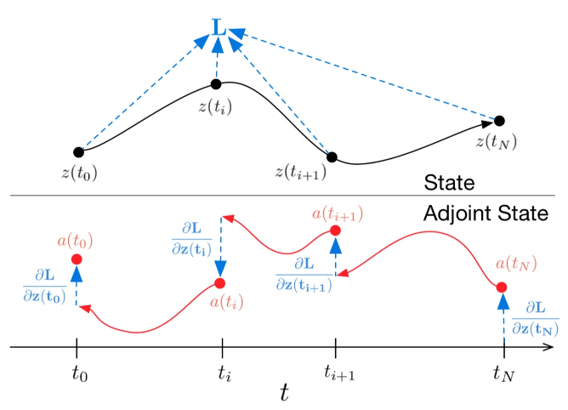
Solving Ordinary Differential Equations with PINNs
1
Problem Formulation
The first step in solving ODEs with PINNs is to formulate the problem, which involves defining the governing ODE, the initial and boundary conditions, and the desired output.
2
Neural Network Architecture
A neural network is then designed to represent the solution to the ODE. The network's architecture is chosen to effectively capture the underlying physics of the problem.
3
Training the PINN
The PINN is trained by minimizing a loss function that combines the residual of the ODE and the error in satisfying the initial and boundary conditions. This ensures that the neural network's output closely matches the true solution.

Slide 9


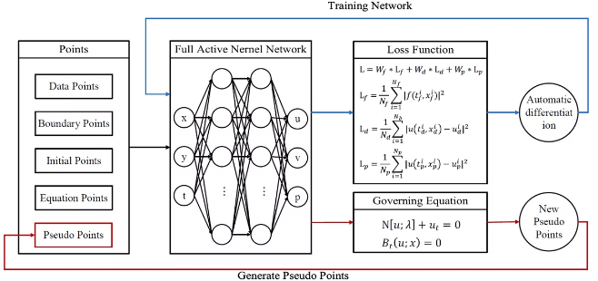
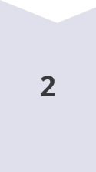

Solving Partial Differential Equations with PINNs
Problem Formulation
The first step in solving PDEs with PINNs is to define the governing PDE, the initial and boundary conditions, and the desired output.
Neural Network Architecture
A neural network is designed to represent the solution to the PDE, with the network's architecture chosen to capture the underlying physics effectively.
Training the PINN
The PINN is trained by minimizing a loss function that combines the residual of the PDE and the error in satisfying the initial and boundary conditions, ensuring the neural network's output closely matches the true solution. We observe that the process of solving ODEs and PDEs are not that different using PINNs

Slide 10


Implementing PINNs using PyTorch
Define the Neural Network
Implement the Physical Constraints
To implement PINNs in PyTorch, you first need to define the neural network architecture that will encode the physical laws. This can be done using PyTorch's nn.Module class, which allows you to create custom neural network models.
Next, you need to define the physical constraints and incorporate them into the neural network's loss function. PyTorch's autograd feature enables efficient computation of gradients, which is crucial for training PINNs.
Train the PINN Model
Evaluate and Analyze
The PINN model is then trained by minimizing the combined loss function, which includes both the data-driven loss and the physics-informed loss. PyTorch's optimization algorithms, such as Adam or SGD, can be used to update the model parameters during training.
Finally, you can evaluate the PINN model's performance and analyze the results, leveraging PyTorch's visualization and evaluation tools to gain insights into the model's predictions and the integrated physical knowledge.

Slide 11





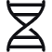
Implementing PINNs using TensorFlow
Model Definition
Physical Constraints
In TensorFlow, you can define the PINN model using the Keras API, which provides a high-level interface for building and training neural networks.
The physical constraints are then incorporated into the model's loss function, leveraging TensorFlow's automatic differentiation capabilities to compute the gradients efficiently.
Training and Optimization
Evaluation and Visualization
The PINN model is trained by minimizing the combined loss function using TensorFlow's powerful optimization algorithms, such as Adam or SGD.
TensorFlow provides a rich set of tools for evaluating the PINN model's performance and visualizing the results, helping you gain insights into the integrated physical knowledge.

Slide 12
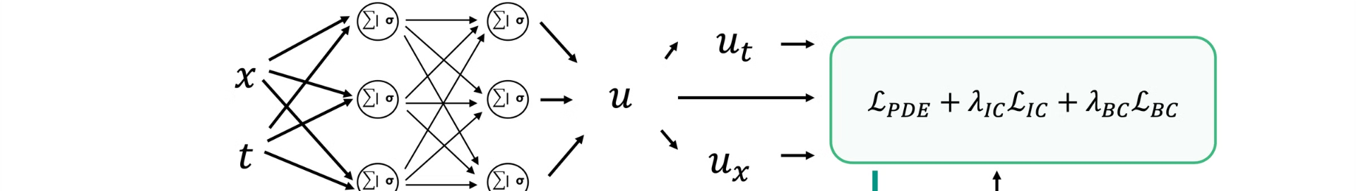
Handling Initial Conditions in PINNs
Incorporating Initial Conditions
Loss Function Modification
In addition to boundary conditions, PINNs can also incorporate initial conditions, which define the starting state of the system. This is particularly important for time-dependent problems, where the initial state of the system plays a crucial role in the evolution of the solution.
To handle initial conditions, the PINN's loss function is modified to include a term that measures the discrepancy between the neural network's predictions and the known initial conditions. This ensures that the model's outputs satisfy the prescribed initial state of the system.
Automatic Differentiation
Time-Dependent Problems
PINNs leverage automatic differentiation to efficiently compute the gradients of the initial condition term in the loss function, enabling the model to be trained effectively and learn the correct initial state of the system.
The ability to incorporate initial conditions is particularly important for time-dependent problems, where the evolution of the system over time is governed by the underlying physical laws and the starting state of the system.

Slide 13
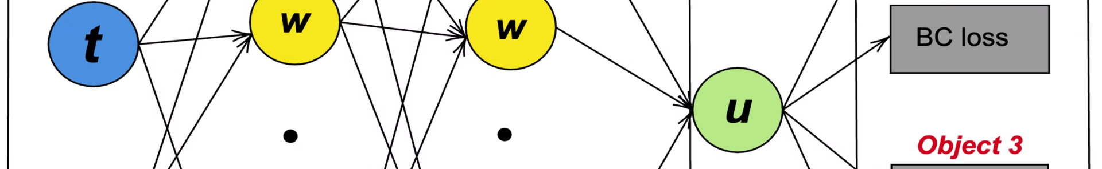



Handling Boundary Conditions in PINNs
Dirichlet Boundary Conditions
Neumann Boundary Conditions
Mixed Boundary Conditions
Dirichlet boundary conditions specify the value of the solution at the domain boundaries. PINNs can incorporate these conditions directly into the neural network architecture, ensuring that the model's predictions satisfy the given constraints.
Neumann boundary conditions specify the gradient or derivative of the solution at the domain boundaries. PINNs can handle these conditions by including the gradient information in the loss function, forcing the model to satisfy the physical constraints.
PINNs can also handle more complex boundary conditions, such as mixed Dirichlet and Neumann conditions, by combining the appropriate terms in the loss function to ensure that the model's predictions adhere to the specified constraints.

Slide 14



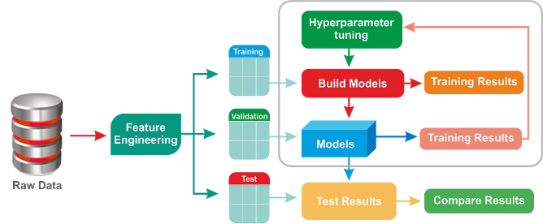


Hyperparameter Tuning and Optimization Strategies
Network Architecture
Loss Function Design
The choice of the neural network architecture, such as the number of layers, neurons, and activation functions, can significantly impact the performance of PINNs. Systematic exploration and optimization of the network structure are crucial for achieving optimal results.
The formulation of the loss function, including the weighting of the different terms representing the physical constraints and the observed data, requires careful consideration to ensure the convergence and stability of the training process.
Optimization Techniques
Regularization Strategies
The choice of optimization algorithms, such as stochastic gradient descent, Adam, or L-BFGS, can greatly impact the convergence and performance of PINNs. Ongoing research explores more advanced optimization strategies to improve the training efficiency of PINNs.
Appropriate regularization techniques, such as L1/L2 regularization, dropout, or weight sharing, can help mitigate overfitting and improve the generalization capabilities of PINNs, especially for problems with limited training data.

Slide 15

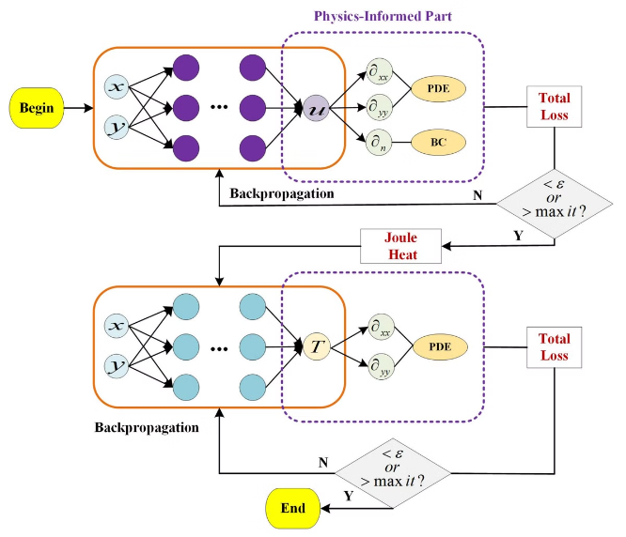

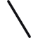
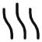

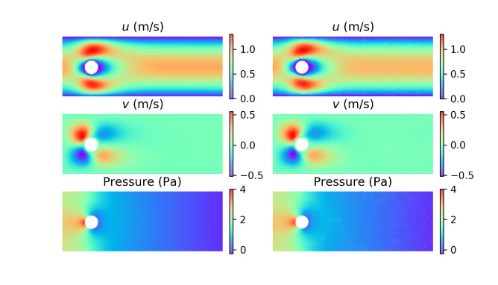
PINNs for Multiphysics Simulations
Fluid Dynamics
Solid Mechanics
PINNs can seamlessly couple fluid dynamics with other physical processes, such as solid mechanics or heat transfer, enabling the modeling of complex multiphysics phenomena.
PINNs can integrate structural mechanics with other physical aspects, such as thermal effects or fluid-structure interactions, providing a unified modeling approach for multiphysics problems.
Heat Transfer
Coupled Processes
PINNs can couple heat transfer with other physical processes, such as phase changes or chemical reactions, enabling the simulation of complex thermal-fluid-chemical systems.
PINNs can handle the interplay between multiple physical processes, such as the interaction between structural deformation and electromagnetic fields, leading to a comprehensive modeling framework.

Slide 16

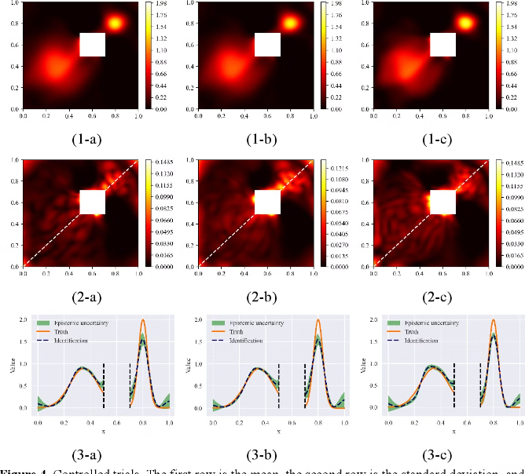
PINNs for Uncertainty Quantification
Probabilistic Modeling
PINNs can incorporate probabilistic inputs, such as random material properties or boundary conditions, to quantify the uncertainty in the model's predictions.
Sensitivity Analysis
PINNs can be used to perform sensitivity analysis, identifying the most influential parameters that drive the uncertainty in the model's outputs.
Monte Carlo Simulations
PINNs can be efficiently integrated with Monte Carlo techniques to propagate uncertainty through the model, enabling comprehensive uncertainty quantification.
Robust Optimization
PINNs can be leveraged in robust optimization frameworks, ensuring that the model's predictions are reliable and insensitive to uncertainties in the input parameters.

Slide 17
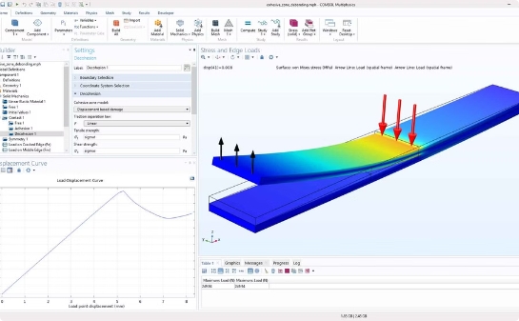
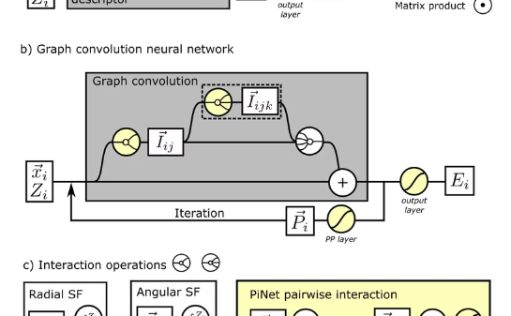
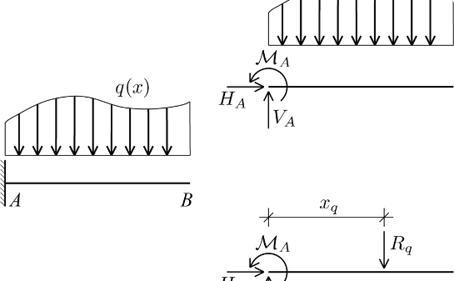
Applications of PINNs in Solid Mechanics
Structural Analysis
Material Modeling
Geomechanics
PINNs can be employed to model the mechanical response of structures, including linear and nonlinear deformations, stress and strain distributions, and failure mechanisms, facilitating the design and optimization of engineering components.
PINNs can capture the complex constitutive behavior of materials, such as plasticity, viscoelasticity, and phase transformations, enabling the development of accurate material models for a wide range of engineering applications.
PINNs can be applied to model the behavior of geological materials, including soil and rock, allowing for the simulation of phenomena like subsidence, fracture propagation, and fluid-solid interactions in the context of energy, mining, and infrastructure engineering.

Slide 18
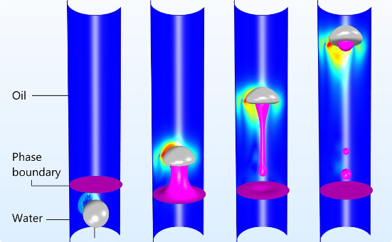
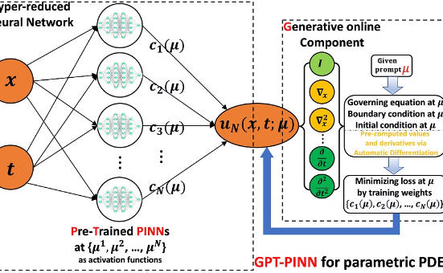
Illustrative Examples of PINN Applications
Fluid Dynamics
Heat Transfer
Structural Mechanics
PINNs have been successfully applied to solve complex fluid dynamics problems, such as modeling the flow around an airfoil or the dynamics of a turbulent wake. By incorporating the Navier-Stokes equations and boundary conditions, PINNs can predict the velocity, pressure, and other relevant flow variables with high accuracy.
PINNs have demonstrated their capabilities in solving heat transfer problems, such as modeling the temperature distribution in a solid object or the heat flux across a solid-fluid interface. The integration of the governing heat transfer equations and boundary conditions allows PINNs to capture the complex thermal phenomena accurately.
PINNs have been applied to tackle problems in structural mechanics, such as predicting the deformation and stresses in a loaded structure. By incorporating the relevant constitutive laws and boundary conditions, PINNs can provide reliable solutions that satisfy the physical constraints of the problem.

Slide 19
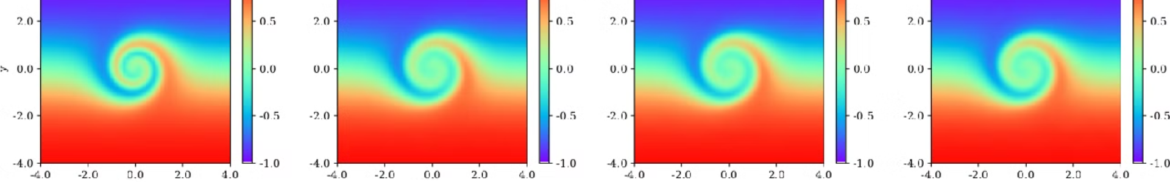
Comparison to Traditional Numerical Methods
Numerical Methods
PINNs
Rely on discretization of the domain and numerical approximation of derivatives
Utilize continuous neural networks to learn the underlying solutions
Often require extensive computational resources, especially for complex geometries or high-dimensional problems
Can be more computationally efficient, especially for high-dimensional and complex problems
Require explicit specification of boundary conditions and initial conditions
Can automatically incorporate boundary and initial conditions into the neural network architecture
May struggle with generalization to unseen scenarios
Can potentially generalize better by learning the underlying physical principles

Slide 20

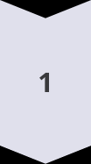

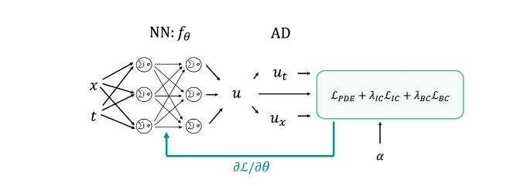

Challenges and Limitations of PINNs
Sensitivity to Hyperparameters
PINNs can be sensitive to the choice of hyperparameters, such as the network architecture, learning rate, and the weighting of the different loss terms. Careful tuning and optimization of these hyperparameters are often required to achieve optimal performance.
Computational Expense
The process of training a PINN can be computationally intensive, especially for complex physical problems with a large number of input variables and constraints. Efficient optimization techniques and hardware acceleration are often necessary to make PINNs scalable and practical for real-world applications.
Generalization Challenges
While PINNs can improve generalization compared to traditional data-driven approaches, they may still face challenges in extrapolating to scenarios significantly different from the training data. Ongoing research focuses on developing strategies to enhance the generalization capabilities of PINNs.
Interpretability and Explainability
4
While PINNs offer improved interpretability compared to traditional data-driven models, further research is needed to enhance the explainability of their predictions and to provide a deeper understanding of the learned physical relationships.

Slide 21
Thank You!
Presentation by: Deborshi Chakrabarti

